Slide 1
CHAPTER 6
E-BUSINESS STRATEGY

Slide 2
Learning outcomes
Follow an appropriate strategy process model for e-business;
Apply tools to generate and select e-business strategies;
Outline alternative strategic approaches to achieve e-business.

Slide 3
Management issues
How does e-business strategy differ from traditional business strategy?
How should we integrate e-business strategy with existing business and IS strategy?
How should we evaluate our investment priorities and returns from e-business?

Slide 4
E-business Strategy
Strategy
Definition of the future direction and actions of a company defined as approaches to achieve specific objectives

Slide 5
Alternative definitions of strategy
What is strategy?
  “Defines how we will meet our objectives”
  “Sets allocation of resources to meet goals”
  “Selects preferred strategic options to
  compete within a market”
  “Provides a long-term plan for the development of the organization”.

Slide 6
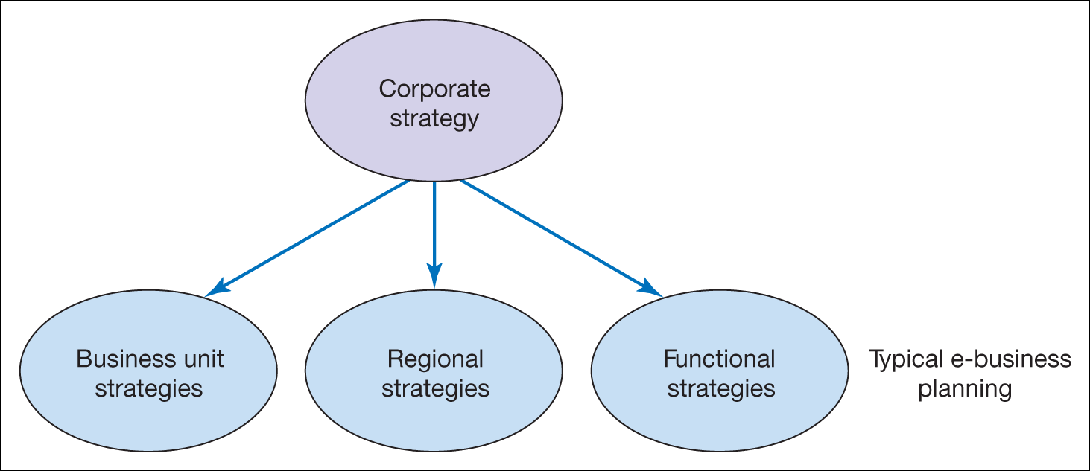
Figure 5.1 Different forms of organizational strategy

Slide 7
The imperatives for e-business strategy
Missed opportunities from lack of evaluation of opportunities
Inappropriate direction of e-business strategy
Limited integration of e-business at a technical level
Resource wastage

Slide 8
E-channel strategies
How a company should set specific objectives and develop specific differential strategies for communicating with its customers and partners through e-media

Slide 9
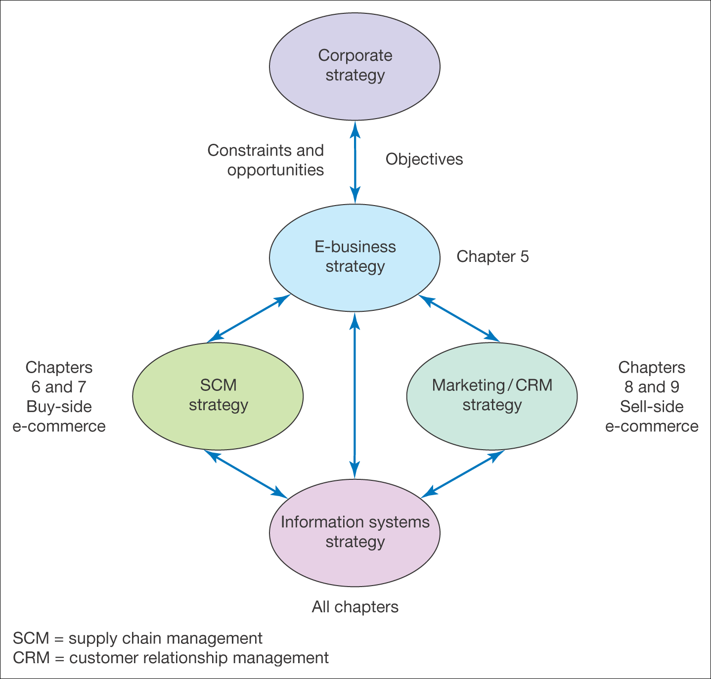
Figure 5.2 Relationship between e-business strategy and other strategies

Slide 10
Multi-channel e-business strategies
Characteristics:
  E-business strategy is a channel strategy
  Specific e-business objectives need to be set
  Creating differential values
  Defines how an organization gains value internally

Slide 11
What happens where there is no e-business strategy?
Missed opportunities for additional sales on the sell-side and more efficient purchasing on the buy-side
Fall-behind competitors in delivering online services – may become difficult to catch-up, e.g. Tesco, Dell
Poor customer experience from poorly integrated channels.

Slide 12
Strategy process models
A management team needs to agree on the framework they will follow
Common element:
  Internal and external environment scanning
  A clear statement of vision and objectives
  Can be broken down to option generation, evaluation and selection
  Implementation
  Control is required

Slide 13
Suggestions on e-business strategy
Hackbarth and Kettinger (2000)
  Four-stage ‘strategic e-breakout’
Deise et al. (2000)
  Approach based on work conducted on PWC
Rowley (2002)
  Strategy development similar with other business context
Venkatram (2000)
  Five-stage strategy process

Slide 14
Venkatram (2000)
What is your strategic vision?
How do you govern dot-com operations?
How do you allocate key resources?
What is your operating infrastructure?
Is your management team aligned for the dot-com agenda?

Slide 15
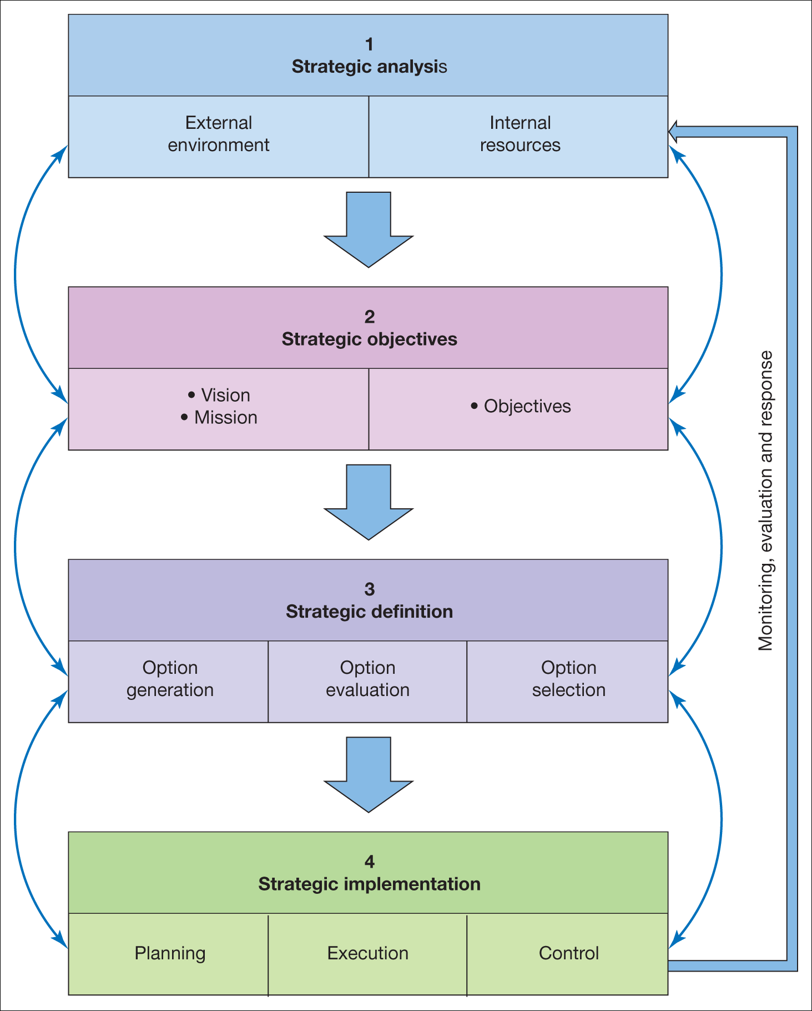
Figure 5.4 A generic strategy process model

Slide 16
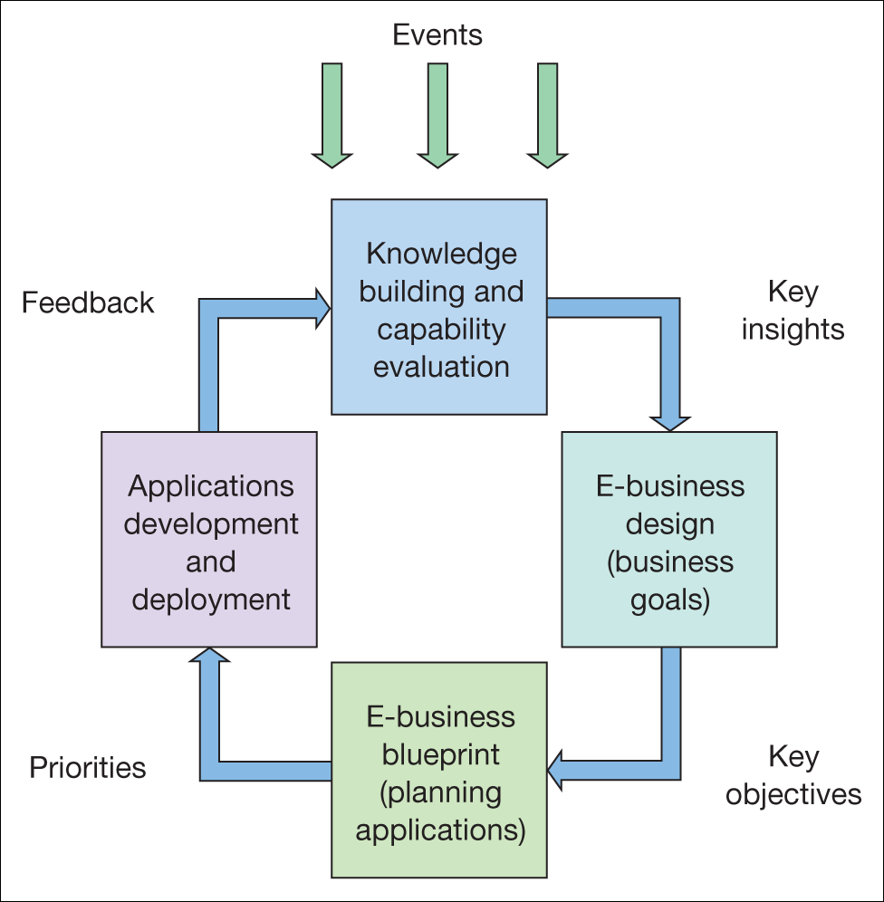
Figure 5.5 Dynamic e-business strategy model
Source: Adapted from description in Kalakota and Robinson (2000)

Slide 17
Strategic Analysis
Collection and review of information about an organization’s internal processes and resources and external marketplace factors in order to inform strategy definition
Involves reviews of:
  Resources and processes
  Competitive environment
  Wider environment

Slide 18
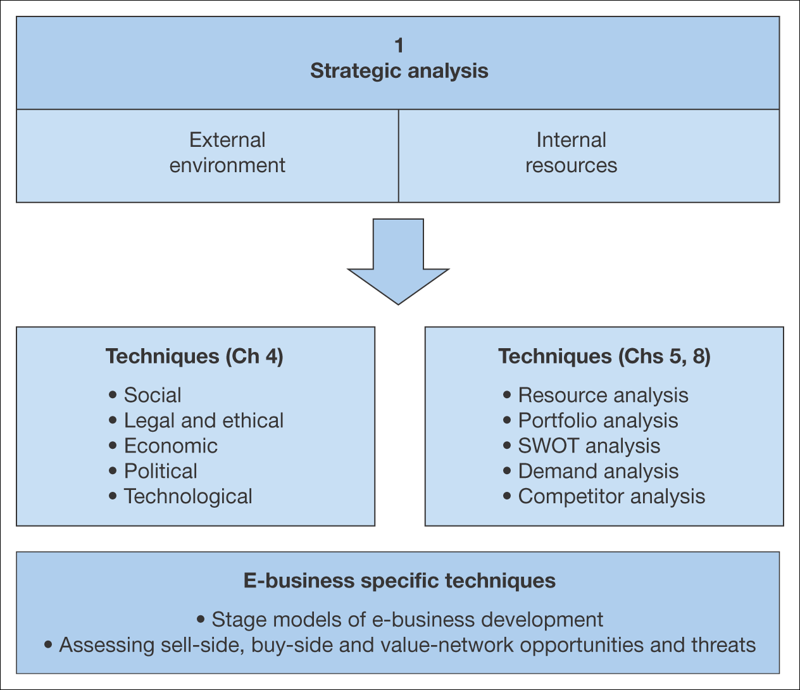
Figure 5.6 Elements of strategic situation analysis for the e-business

Slide 19
Resource Analysis
Review of the technological, financial and human resources of an organization and how they are utilized in business processes

Slide 20
Decision on marketing services
Level 0: No web site or presence on the web
Level 1: Basic web presence
Level 2: Simple static informational web site
Level 3: Simple interactive site
Level 4: Interactive site supporting transaction with users
Level 5: Fully interactive site supporting the whole buying process

Slide 21
Product sourcing development (Buy-side E-Commerce)
Level I: No use of the web
Level II: Review and selection from competing suppliers using intermediary web
Level III: Orders placed electronically through EDI
Level IV: Orders placed electronically with integration of company’s procurement system
Level V: Orders placed electronically with full integration of company’s procurement, manufacturing requirements planning and stock control system

Slide 22
Applications portfolio analysis
Used to assess current information systems capability and also to inform future strategies

Slide 23
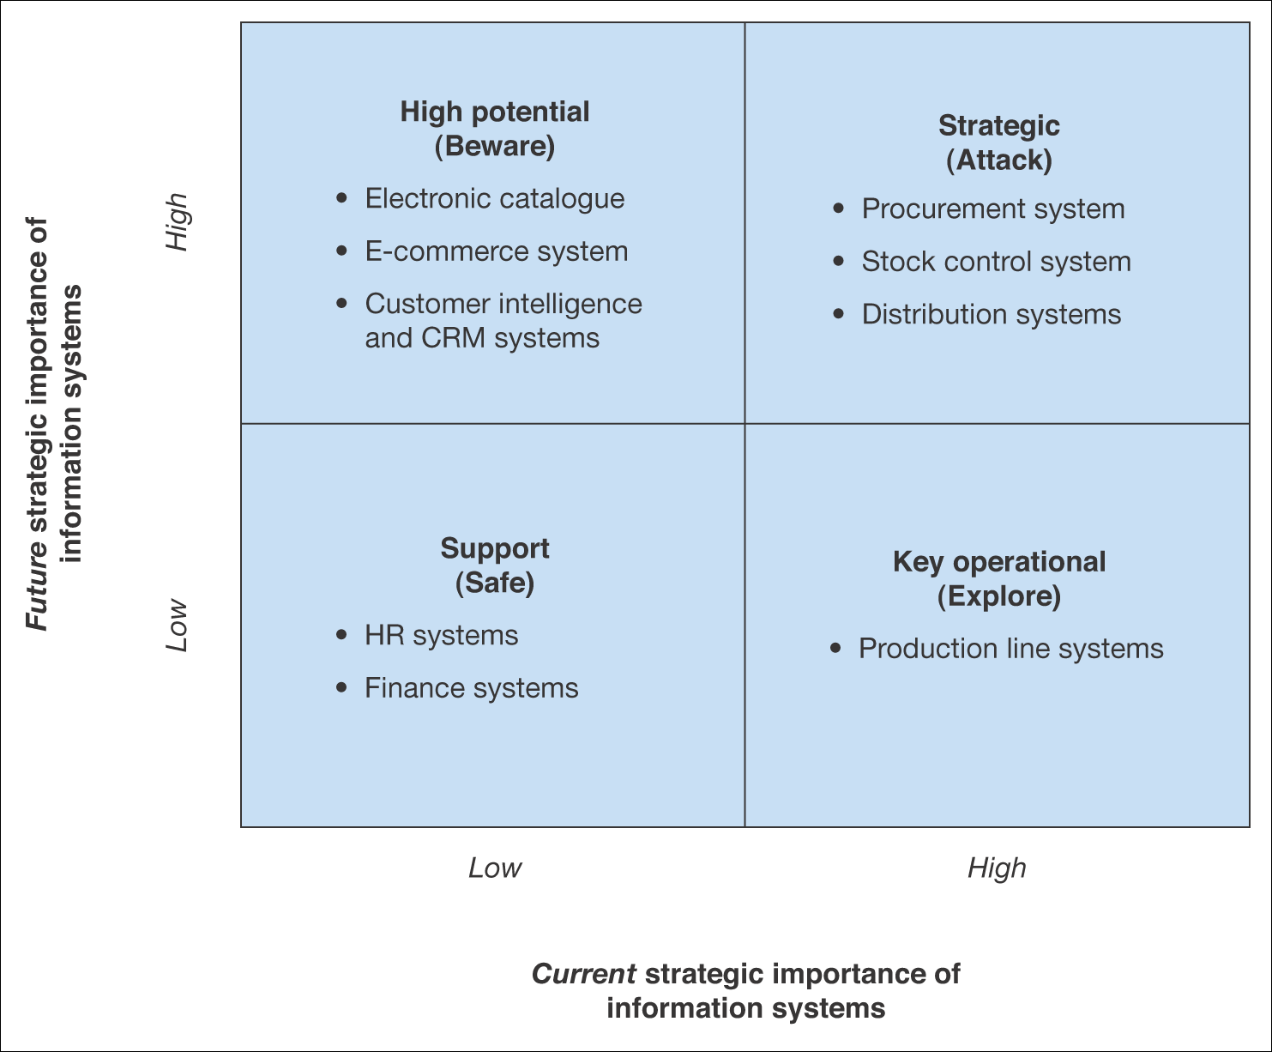
Figure 5.7 Summary applications of a portfolio analysis for The B2B Company

Slide 24
Organizational and IS SWOT analysis
Help organization analyze their resources in term of strengths and weaknesses and match them against threats and opportunities

Slide 25
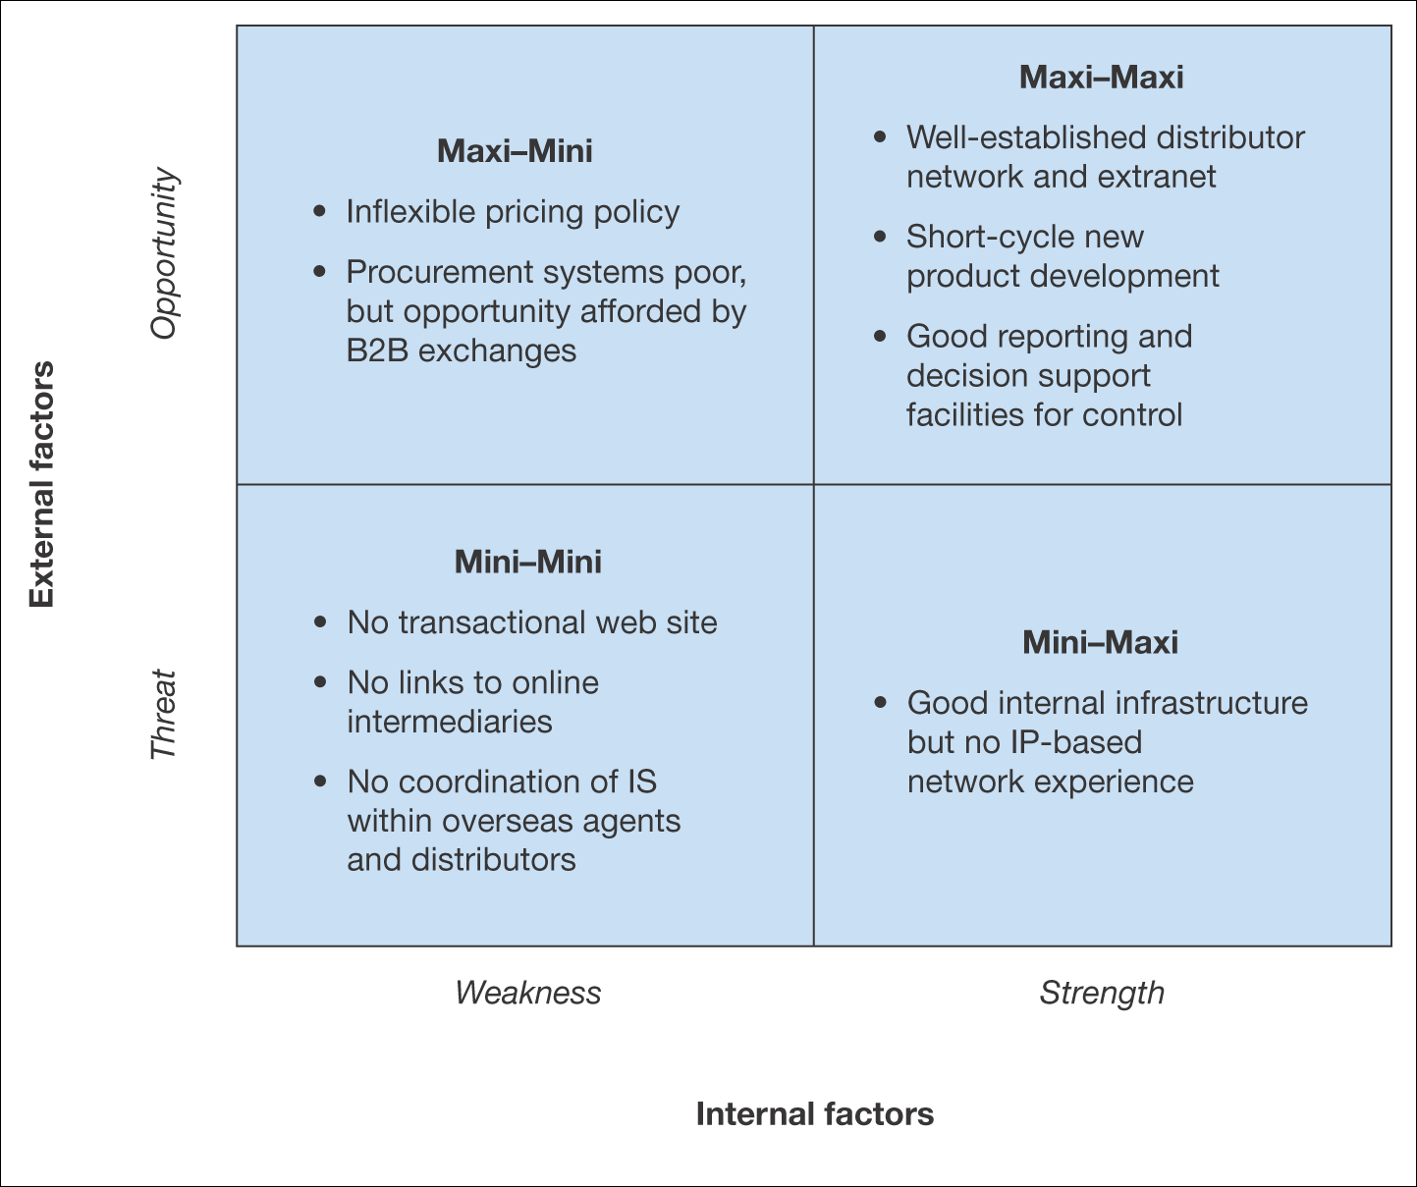
Figure 5.8 SWOT analysis for The B2B Company

Slide 26
Human and financial resources
Human resources
Financial resources

Slide 27
Demand Analysis
Assessment of the demand for e-commerce services amongst existing and potential customer segments

Slide 28
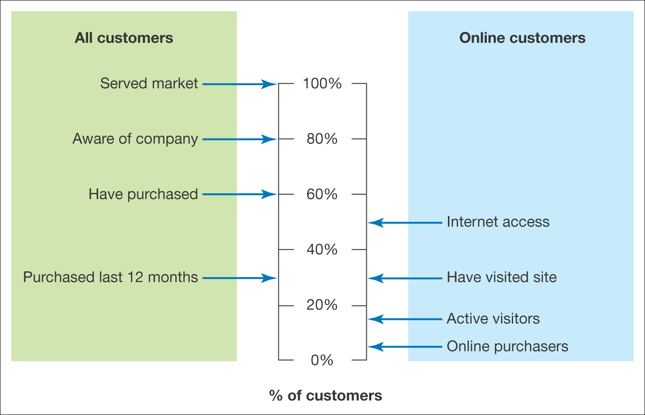
Figure 5.9 Customer demand for e-marketing services for The B2B Company

Slide 29
Competitive Threats
Threat of new e-commerce entrants
Threats of new digital products
Threat of new business models

Slide 30
Sell-side threats
Customer power and knowledge
  Use Internet to evaluate products and compare prices
Power of intermediaries
  Channel conflicts result of disintermediation

Slide 31
Buy-side threats
Power of suppliers
  An opportunity for buyers
Power of intermediaries
  Risk include cost of integration

Slide 32
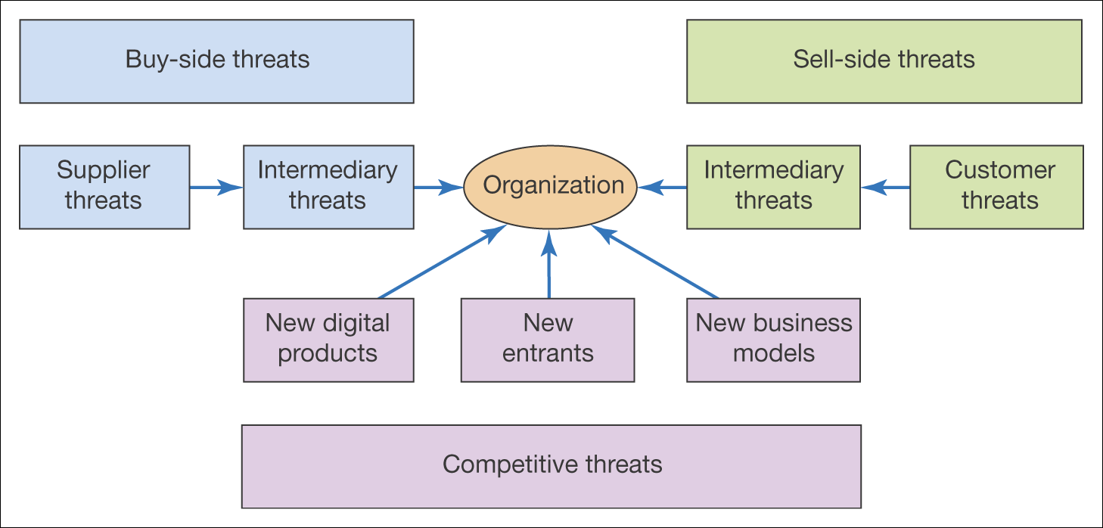
Figure 5.10 Competitive threats acting on the e-business

Slide 33
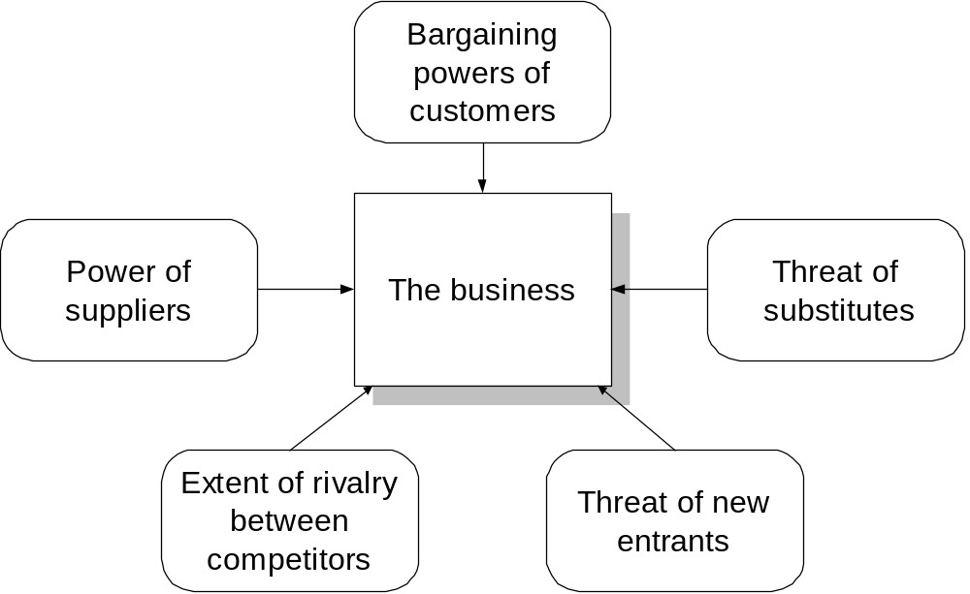
Porter’s five forces

Slide 34
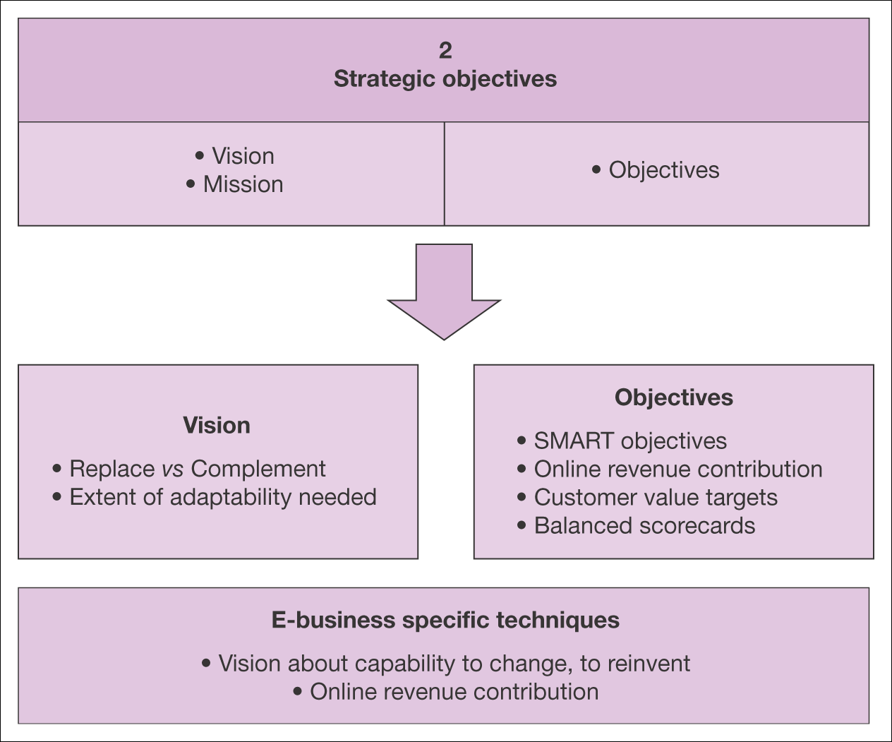
Figure 5.11 Elements of strategic objective setting for the e-business

Slide 35
Defining vision and mission
Company vision will be based on the managers’ view of the future relevance of the Internet to their industry
Can the Internet primarily complement the company other channel or whether it will replace other channel?
  Customer access to Internet is high
  Offer a better value proposition
  Product can be delivered over the Internet
  Product can be standardized

Slide 36
How can e-business create business value?
Adding value
  Providing better-quality products and services
Reduce costs
  Making business process more efficient
Manage risks
  Create different functions and professions
Create new reality
  Can be used to innovate

Slide 37
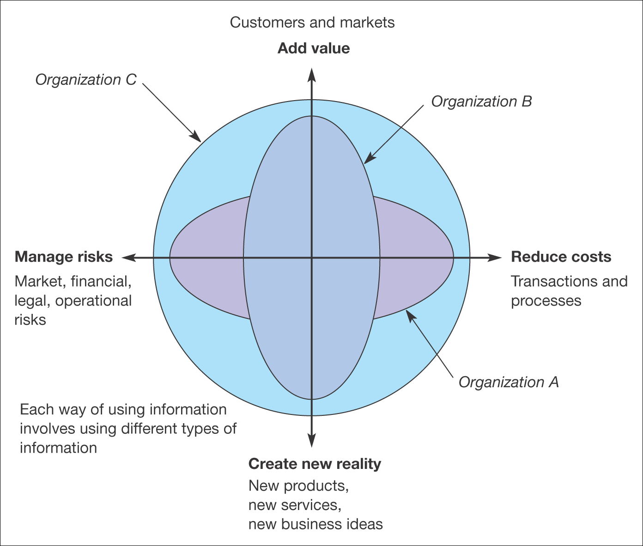
Figure 5.12 An evaluation tool relating information to business value. An organization’s use of information on each axis can be assessed from 1 (low use
of information) to 10 (high use of information)
Source: Marchand et al. eds (1999)

Slide 38
Objective Setting
Objectives
  Develop revenue from new geographical markets
Strategies to achieve goals
  Create EC facility for standard products and assign agents to these markets
Key performance indicators
  Achieve combined revenue of RM1mil by year-end online revenue contribution of 70%

Slide 39
Online Revenue Contribution
States the percentage of company revenue directly generated through online transaction

Slide 40
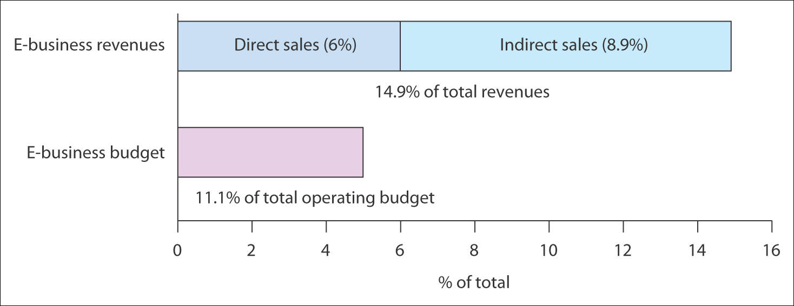
Figure 5.14 Direct and indirect Internet contributions for fast-growth companies in
the USA
Source: PricewaterhouseCoopers (2000)

Slide 41
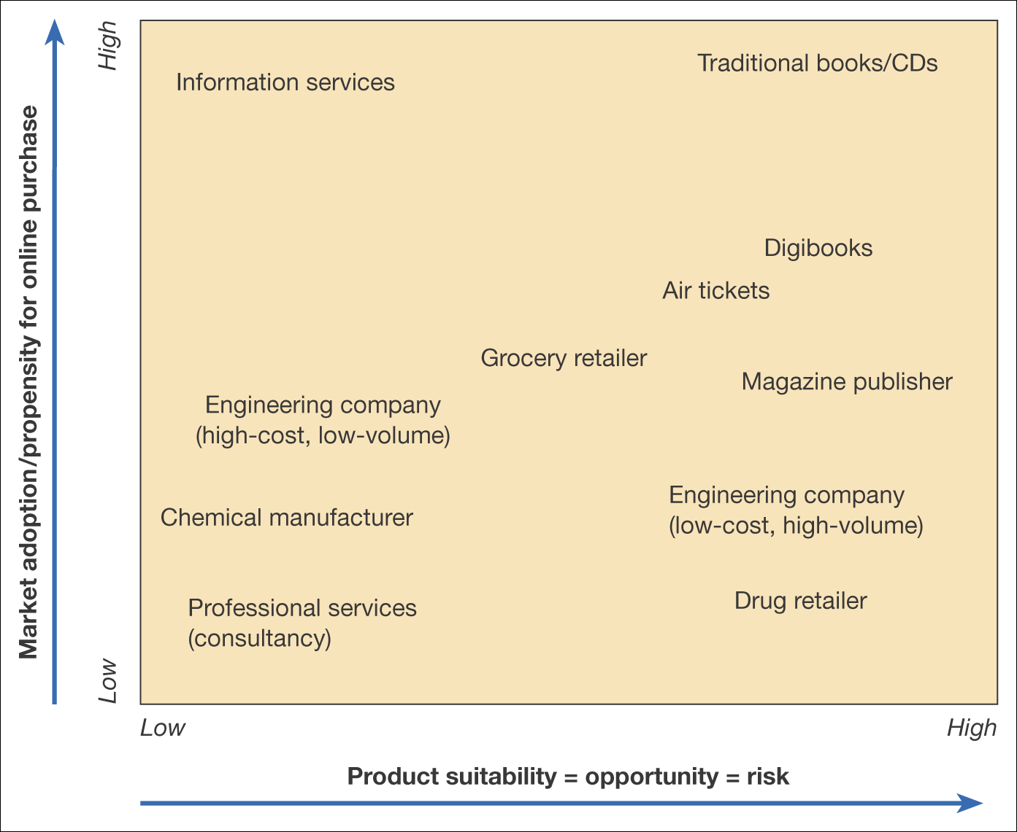
Figure 5.15 Grid of product suitability against market adoption for transactional
e-commerce (online purchases)

Slide 42
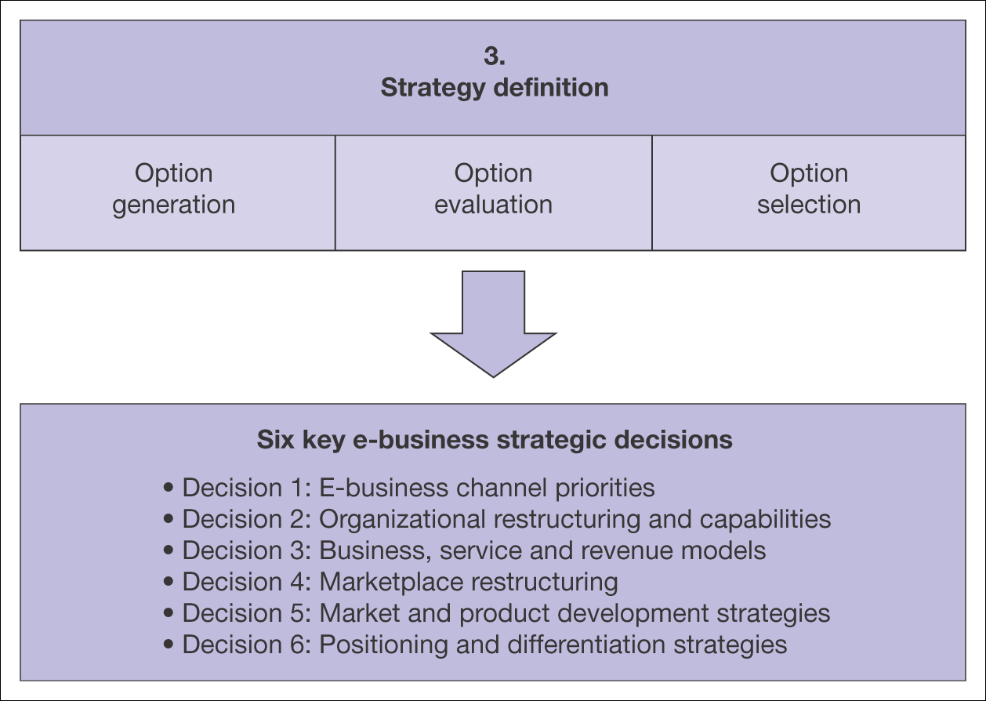
Figure 5.16 Elements of strategy definition for the e-business

Slide 43
Decision 1: E-business channel priorities
Strategic e-commerce alternatives for companies should be selected according to the percentage of target market who can be persuaded to migrate use the e-channel
Bring benefits to the company by bringing higher sales volume and reduce costs for customer acquisition and retention

Slide 44
Right Channelling
Right channelling can be summarized as:
  Reaching the right customer
    Using the right channel
      With the right message or offering
        At the right time
Examples:
  B2B serve SMEs through e-channels and larger clients through personal service
  Encourage consumers to buy and serve through lower cost electronic channels
  Encourage offline fulfillment/conversion as appropriate
  Different levels of service/promotion for different customers.

Slide 45
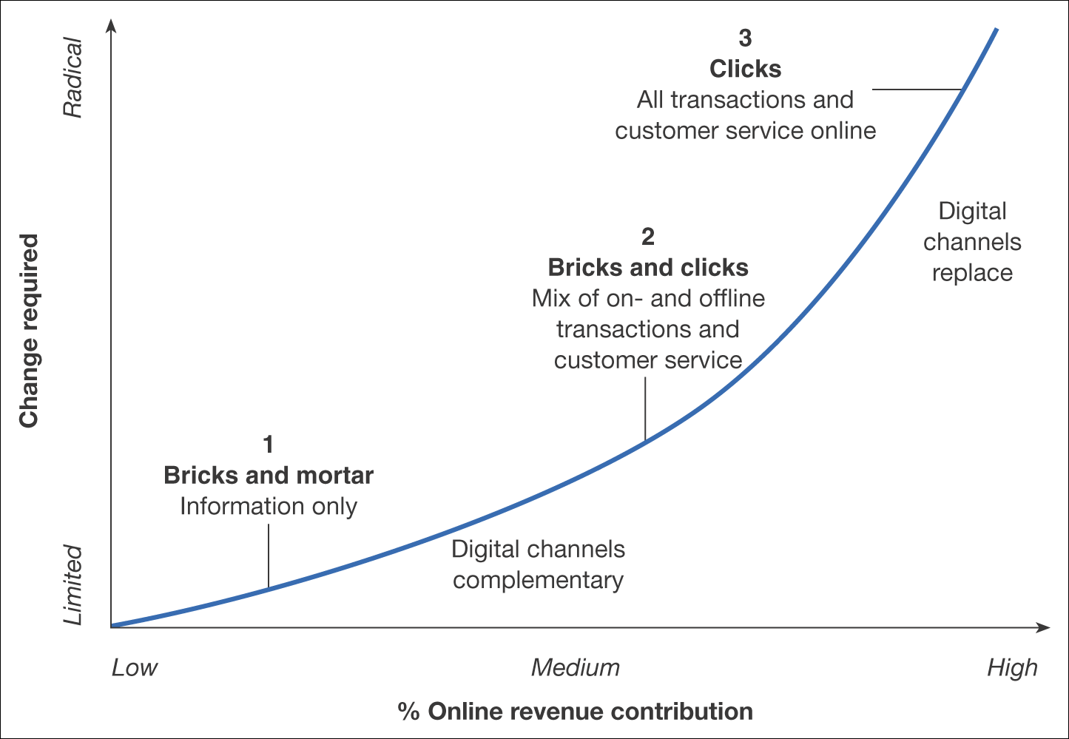
Figure 5.17 Strategic options for a company in relation to the importance of the Internet as a channel

Slide 46
Decision 2: Organizational restructuring
How the company should restructure in order to achieve the priorities set for e-business
The choices are:
  In-house division
  Joint venture
  Strategic partnership
  Spin-off

Slide 47
Decision 3: Business, service and revenue models
Review of opportunities from new business and revenue models
Need to review new revenue opportunities and competitor innovations

Slide 48
Decision 4: Marketplace restructuring
Consider options created through disintermediation and reintermediation

Slide 49
Decision 5: Market and product development strategies
Decide on which market to target

Slide 50
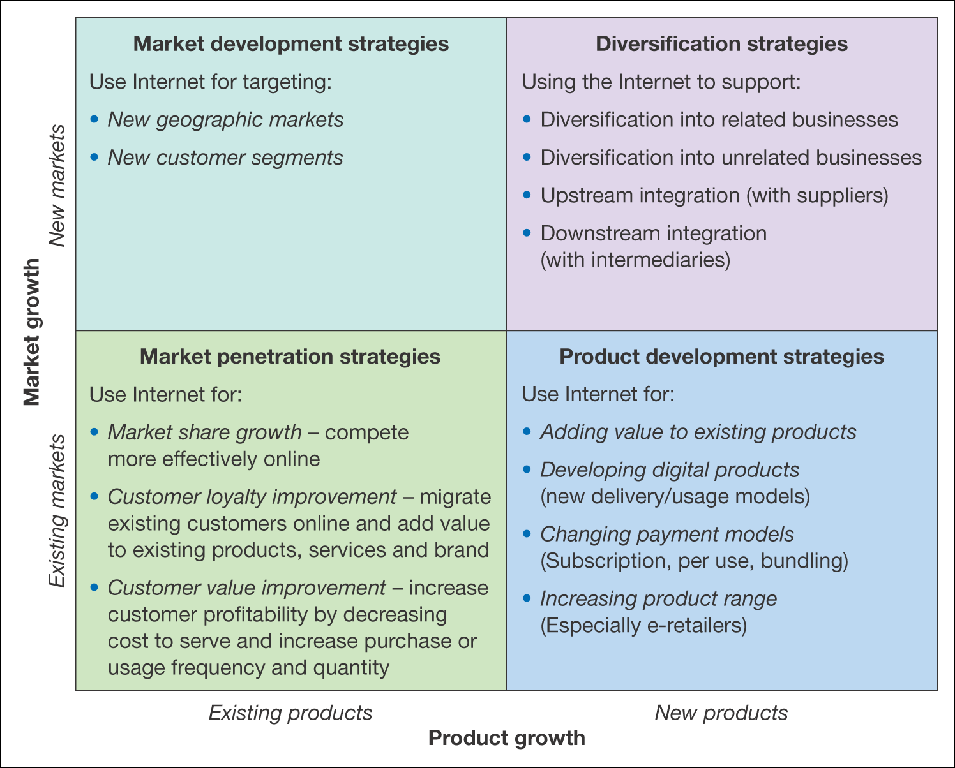
Figure 5.19 Using the Internet to support different growth strategies

Slide 51
Decision 6: Positioning and differentiation strategies
Strategies should review the extent to which increases in product and service quality can be matched by decreases in price and time

Slide 52
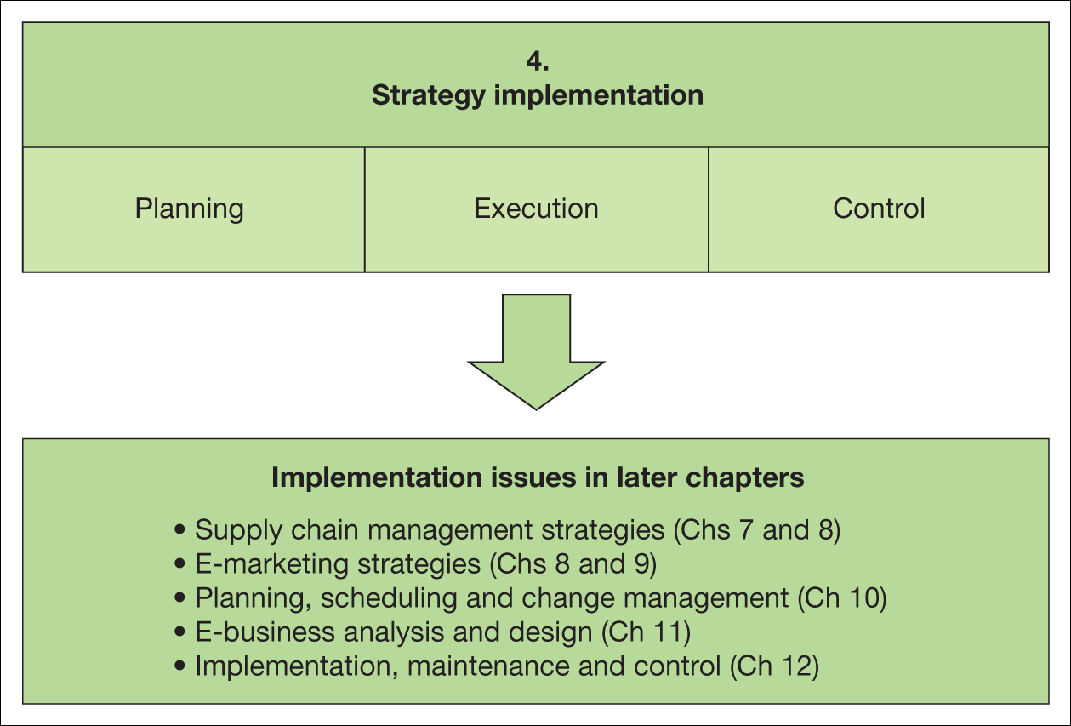
Figure 5.22 Elements of strategy implementation for the e-business

Slide 53
Failed e-business strategies
Timing errors
Lack of creativity
Offering free services
Over-ambition

Slide 54
Classic Mistakes Business Made
Situation analysis
Objective setting
Strategy definition
Implementation

Slide 55
EB Strategy Implementation Success
Content
Convenience
Control
Interaction
Community
Price sensitivity
Brand image
Commitment
Partnership
Process improvement
Integration

